Slide 1




SheSheild
next-gen women's safety app

Slide 2
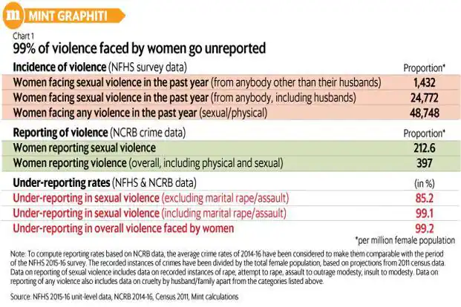


PROBLEM
Crimes against women reported every two minutes in India
Rape cases in India are increasing at the rate of 8% annually in the past 5 years.

Slide 3

SOLUTION
SheShield- An Android app that leverages advanced AI technologies to detect potential threats and safeguards the user from them
Sends SOS to emergency registered contacts containing the GPS location of the user.
Has a voice recognition technology that detect sounds and uses them to trigger the SOS.

Slide 4




TECH STACK
JAVA
ANDROID STUDIO
PYTHON

Slide 5

About Us
NAME | COURSE | STREAM | YEAR OF GRAD | ROLE
AKSHIT SHARMA | B.TECH | AI&DS | 2026 | TEAM LEADER, FULL STACK
SHASHI KANT SHARMA | B.TECH | AI&DS | 2026 | FRONT END
JOYAL JIJO | B.TECH | AI&DS | 2026 | FULL STACK
ANISHA DUA | B.TECH | AI&ML | 2026 | FULL STACK
VINEET GOYAL | B.TECH | AI&DS | 2026 | FRONT END
VANSH SINGHAL | B.TECH | AI&DS | 2026 | MACHINE LEARNING

Slide 6
Thank
you!

